Slide 1
Secure Settings – Identify Options
Charles Wilson
Staff Product Cybersecurity Architect
version 3
2026-07-09
Notes:
Script:
I'm Charles Wilson, staff product cybersecurity architect at Torc Robotics.
This presentation will cover the Secure Settings – Identify Options activity.

Slide 2
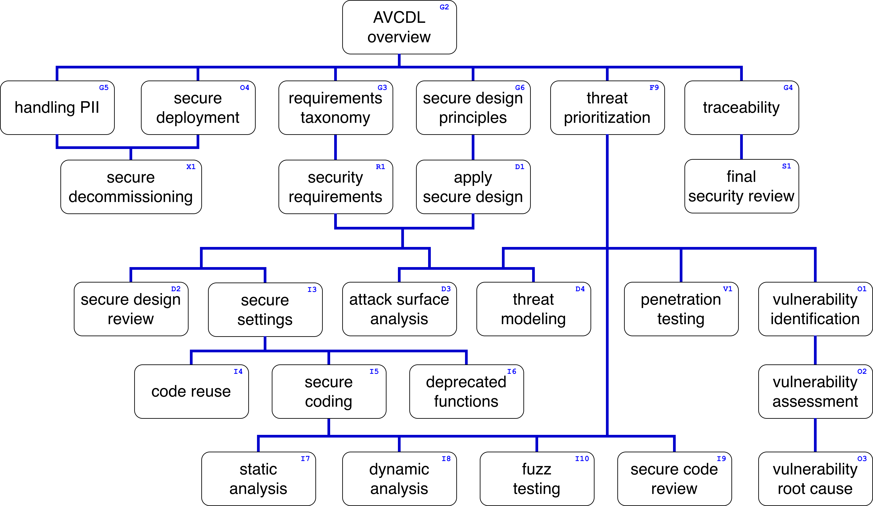
Training Path
Notes:
Script:
This diagram shows the overall AVCDL training path.
If you're taking this training, it's assumed that you've already completed the AVCDL Overview training,
and additionally, that you've completed the
Requirements Taxonomy
Security Requirements
Secure Design Principles
Apply Secure Design
and
Secure Settings Overview
This training will cover the Secure Settings – Option Identification activity.

Slide 3
Introduction
Notes:
Script:
Before getting into option identification, let's briefly review where it fits, in the overall secure settings process.

Slide 4
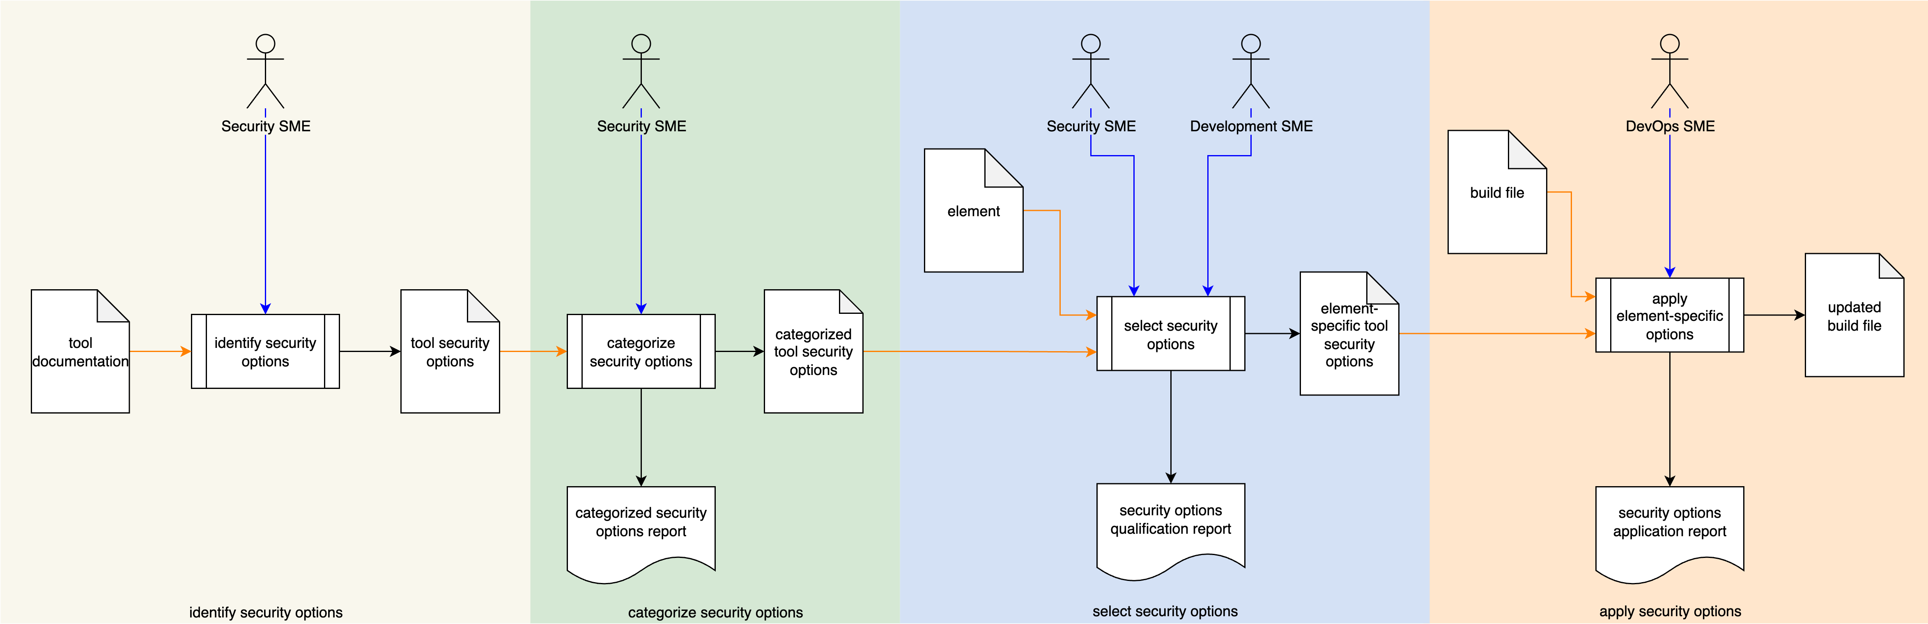
Secure Settings Process
Notes:
Script:
Here's the secure settings process which we previously covered in the Secure Settings Overview.
[break]
Our focus for this training is going to be on the first activity, that of option identification.

Slide 5
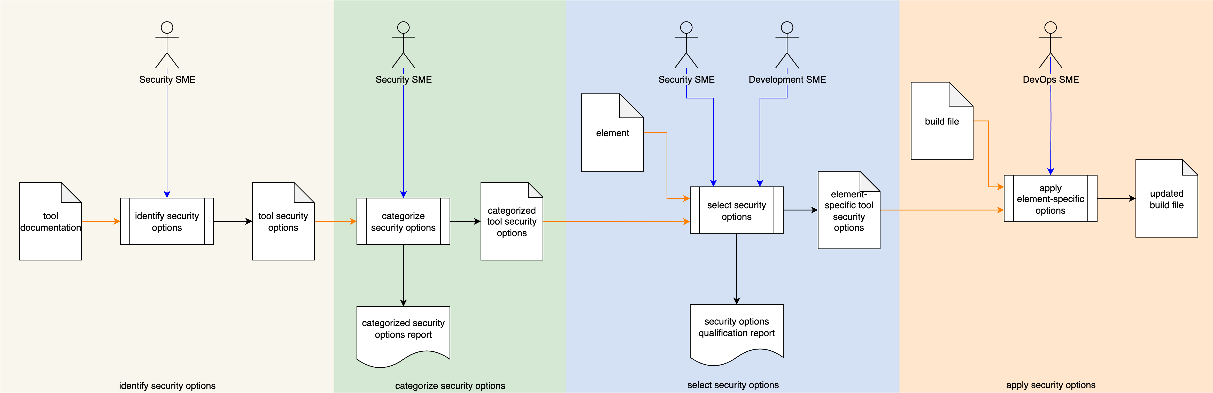
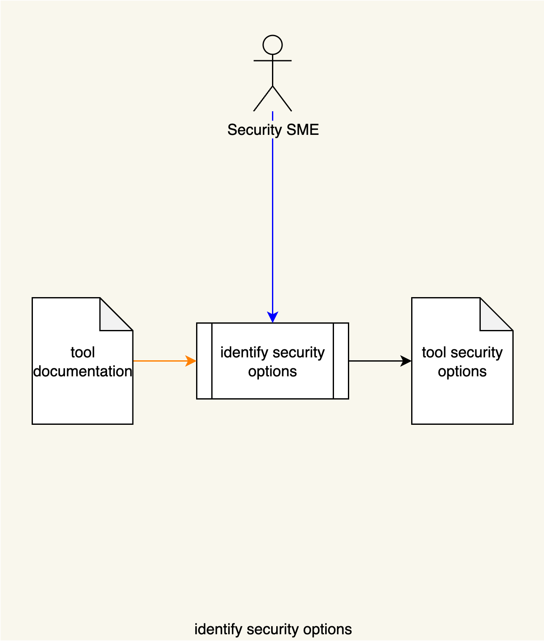
Secure Settings Process
Notes:
Script:
Here's the secure settings process which we previously covered in the Secure Settings Overview.
[break]
Our focus for this training is going to be on the first activity, that of option identification.

Slide 6
Identify Options Activity
Notes:
Script:
Within the identify options activity,
The security SME
[pause]
is going to be taking
[pause]
the tool documentation,
[pause]
examining it, identifying the security options that are there, and
[pause]
creating a tool security options document.

Slide 7
Cybersecurity-relevant Tools
Linters
Compilers
Static Analyzers
Fuzz Testers
Dynamic Analyzers
Notes:
Script:
As a reminder, when we're talking about cybersecurity-relevant tools, we're talking about:
• Linters
• Compilers
• Static Analyzers
• Fuzz Testers
and
• Dynamic Analyzers
These tools either reason on the code directly or work with instrumentations of the binaries produced from the code.
In either case, they expose issues which are cybersecurity-relevant.

Slide 8
Example
Notes:
Script:
Now let's work our way through an example of a tool’s cybersecurity-relevant option identification.
We'll be using the AVCDL tool cybersecurity options template which is described in the accompanying tertiary document that goes along with this training.
It's important to note here that this is just one mechanism for documenting this information.
There are any number of ways this information could be documented.
In an ideal world, you'd use a database to store this information both across tools and versions of tools.

Slide 9
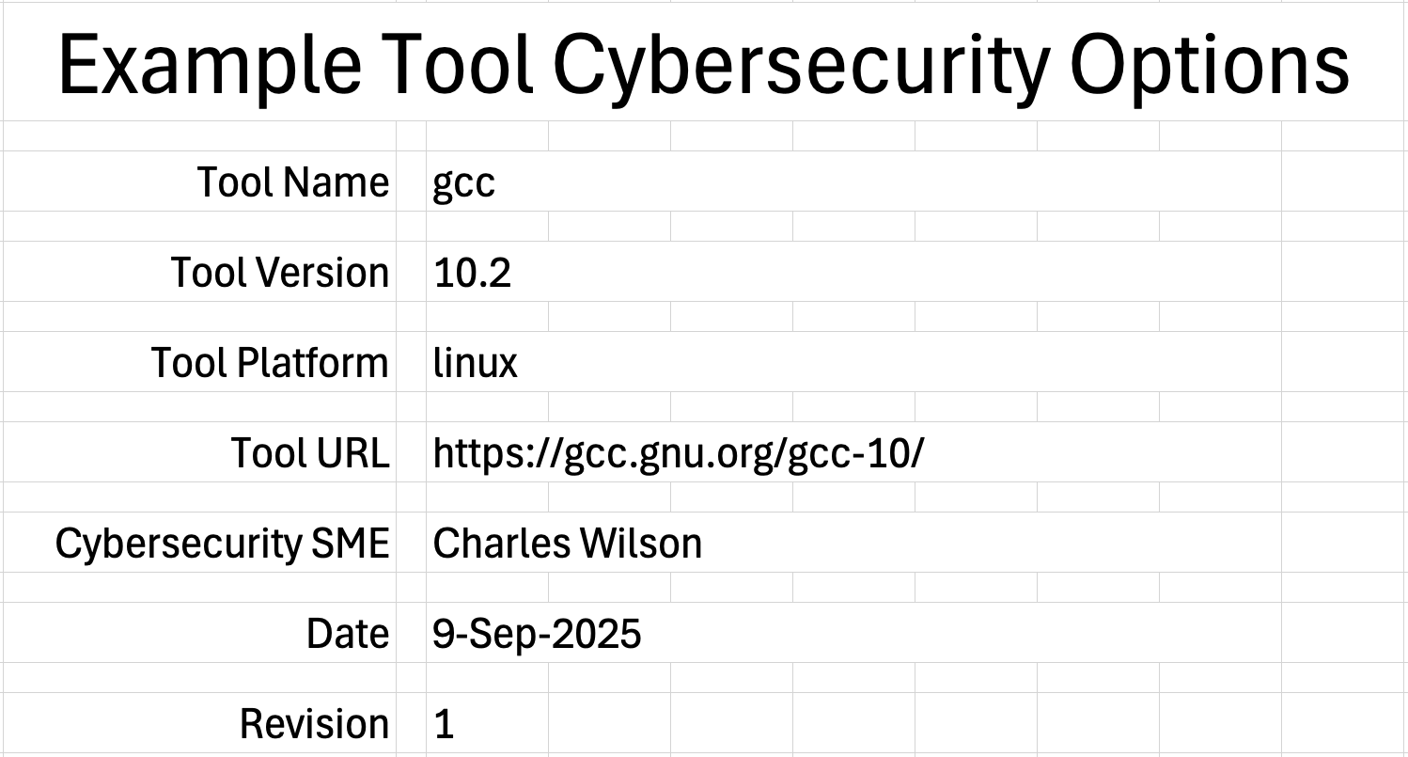
Cover Sheet
Notes:
Script:
For our example, we’ll use the GCC compiler and extract its cybersecurity options, or at least a subset of them.
[pause]
Specifically, we're going to be talking about GCC version 10.2.
This brings up an important point, because as tools evolve, their options can change.
[pause]
Similarly, it's important to know what the platform is.
There are going to be some tools and some options of these tools which have no applicability on a platform of interest.
And so, evaluating them would just waste time.
[pause]
Next, we'll have the location where we can find the tool, and information about the tool.
[pause]
We record the SME who is doing this investigation.
[pause]
The date that the document was updated.
[pause]
And finally, a monotonic and increasing revision.

Slide 10
References
Notes:
Script:
The next and arguably one of the most important steps is that we're going to document all of our references.
This is the documentation used to identify the cybersecurity-relevant options.
It is comprised of a name,
[pause]
a description of the document,
[pause]
and its location.
We see that in our example we call out GCC 10’s general release information.
[pause]
We've got the online documentation for GCC 10.2.
[pause]
We use the C++ core guidelines.
[pause]
The C++ programming language standard.
[pause]
And finally, the MISRA C++ 2023 guidelines.

Slide 11
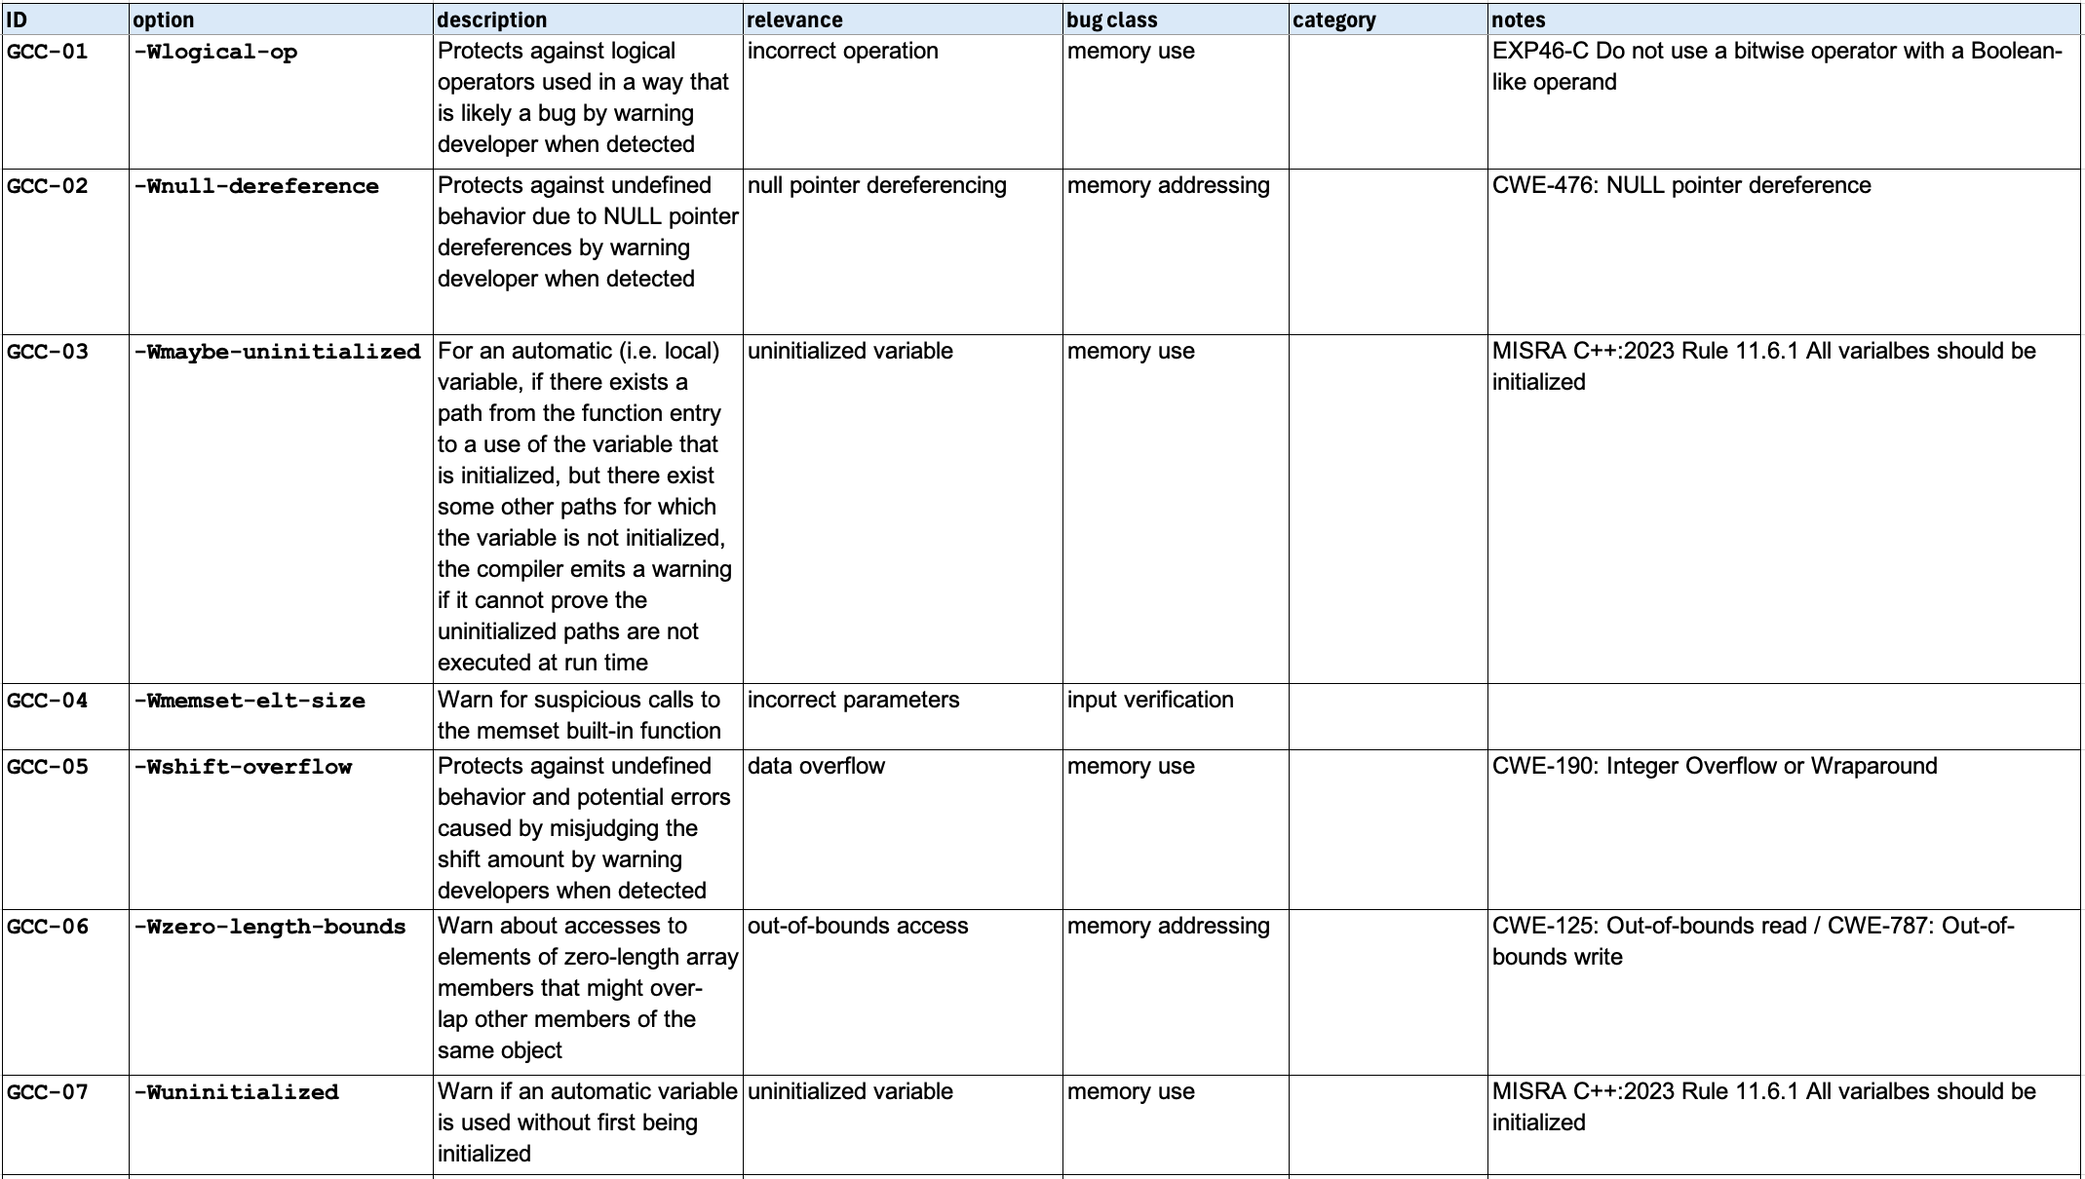
Options
Notes:
Script:
Now we move on to enumerate the tool’s cybersecurity-relevant options.
Our example will only include a small subset of the available cybersecurity options.
The options available in GCC are extremely extensive.
So, this step is probably going to take the greatest amount of time.
This is because the activity requires that the cybersecurity SME appreciate both the tool that's being used (in this case, the compiler) and also the capabilities of the tool are important from a cybersecurity context.
Here we see that we've given these unique IDs.
They’re prefixed with GCC so that we can later use the ID to identify the tool.
We provide the option as it would be used.
And last, the option’s description from the documentation.

Slide 12
Relevance
Notes:
Script:
Once we have all the options enumerated, the next step is to indicate why the option is relevance to cybersecurity.
This doesn't need to be elaborate explanation.
As you can see here, we're using short, concise text to explain why the option is relevant.

Slide 13
NIST Bug Classes
Notes:
Script:
Our next task is to assign a bug class to each option.
We're going to be using the NIST bug framework’s classes mentioned in the overview training.

Slide 14
NIST Bug Class Categories
Input
Memory
Data
Notes:
Script:
As covered in the overview training, the NIST bug class has three categories that it puts these classes into.
These are:
• Input
• Memory
and
• Data
Now, let's get into the specifics of what each of the classes focuses on and what the concerns we have with the bugs that can come from each.

Slide 15
NIST Bug Classes - Input
Class | Focus | Concern
Validation | Format | Data Corruption Command Injection
Verification | Value | Incorrect Behavior
Notes:
Script:
For input, we have two classes.
The first is validation,
[pause]
and our focus here is on the format of the data that's coming in.
[pause]
And our concern is data corruption and command injection.
Here the input is not what it should be.
Say, for instance, you have a field that you're expecting a numeric value to be put in and it gets a string.
Alternately, you expect a simple string to insert into a SQL query but get a compound command.
[pause]
The next is verification.
[pause]
Here you have data, which is of the correct type, but the value is not in range.
[pause]
And this can give us is incorrect behavior.
Say you're using the input as an array index, and it's well beyond what the range of the array is, that's going to give us potentially incorrect behavior.

Slide 16
NIST Bug Classes - Memory
Class | Focus | Concern
Addressing | Pointer Creation Pointer Modification | Out-of-bounds Wrong Object
Management | Memory Allocation Memory Resizing Memory Deallocation | Memory Exhaustion Allocation Too Small
Use | Memory Initialization Memory Read Memory Write | Uninitialized Memory Memory Corruption
Notes:
Script:
In the memory category, we have three classes.
First is addressing, and our focus here is on
[pause]
pointer creation and pointer modification.
[pause]
Our concerns are that we're going to have out of bounds access or are pointing to the wrong object.
The management class is focused on
[pause]
allocation, resizing and deallocation of memory.
[pause]
The concerns here are that we'll end up with memory exhaustion or insufficiently sized allocations.
Finally, we've got memory use and here we're thinking about
[pause]
Initialization and access, the read and write of the memory.
[pause]
Our concerns are that we’ll have uninitialized memory or memory corruption.

Slide 17
NIST Bug Classes - Data
Class | Focus | Concern
Declaration | Definition | Incorrect definition
Name Resolution | Type-Object Binding | Incorrect binding
Type Computation | Type-based Calculations | Incorrect result
Type Conversion | Type Conversion | Data Error Type Error
Notes:
Script:
And our final category is going to be data. It has four classes.
We have the declaration class where our focus is
[pause]
the definition of data.
[pause]
Here we're concerned that we have incorrect object definitions.
[pause]
We have name resolution, and it’s focus is
[pause]
type-object binding.
[pause]
The concern here is that we'll end up with the wrong binding. This can occur with the casting of object with inheritance.
[pause]
Next is type computation, focused on
[pause]
type-based calculations, where we are dealing with things like array handling and offsets.
[pause]
Our concern here is that we'll end up with incorrect results for that.
[pause]
And finally, we have type conversion, where our focus is
[pause]
as the name says, on type conversion, and we can have
[pause]
either data errors or type errors here.
[pause]
One may look at these various classes and ask, “what about undefined behavior and other things that can go wrong?”
From the standpoint of cybersecurity, we're not concerned with things which aren't directly cybersecurity relevant.
These are things which we do not have direct controls for.
There are plenty of switches and issues which have to do with code soundness, and that's fine, but that's not cybersecurity.
It's important as a cybersecurity SME not to overreach into other people's backyards.
There is a tendency to do this because you think, well, “I'm here, I can look at this, I can make this happen.”
The fact of the matter is that that there is plenty for cybersecurity to do without taking on the work of other groups.

Slide 18
Bug Class
Notes:
Script:
Here we see our option sheet extended with the bug class for each of the various options.
As a reminder, the bug class is not there merely for a documentation purpose.
It's there so that when we categorize which bucket each goes into, and when we select the options for use, we’ll have more information to base those decisions on.

Slide 19
Category
Notes:
Script:
The next column in the sheet is that of the category into which the option will fall, and we're not going to touch on this here because that's the subject of the next activity.

Slide 20
Notes
Notes:
Script:
This brings us to the final column and that is notes.
We use this column to provide reference or background material specific to the option.
For instance, If we look at GCC-05 the shift overflow, in addition to the description, saying it’s relevant because we care about data overflows, and the bug class being memory use; we can indicate that it’s the focus of CWE 190 - integer overflows or wraparounds.
Additionally, the option may be supported by multiple things.
If we look at GCC-06, which is the zero-length bounds, which is memory addressing, we have both CWE 125 out-of-bounds read and CWE 787 out-of-bounds write.

Slide 21
Recap
Notes:
Script:
Hopefully you'll appreciate that although perhaps time consuming depending on the tool, that option identification is straightforward.
From the standpoint of being able to justify why particular options are being used, this is a good exercise to go through.
Now let's do a quick recap of the steps that we used.

Slide 22
Summary
Identify the cybersecurity options
Provide the cybersecurity relevance
Assign a bug class
Include supporting references
Notes:
Script:
We're going to start by identifying the cybersecurity options.
We will then provide the reason the option is relevant from a cybersecurity perspective.
We then assign a bug class to each option.
And finally, we'll include any supporting references.

Slide 23
Example Materials
<AVCDL>/source/reference_documents/working_material/secure settings/
Notes:
Script:
The materials that were used to cover this example are in the location shown here.
It's important to note that the workbook includes all the sheets covered in this training.

Slide 24
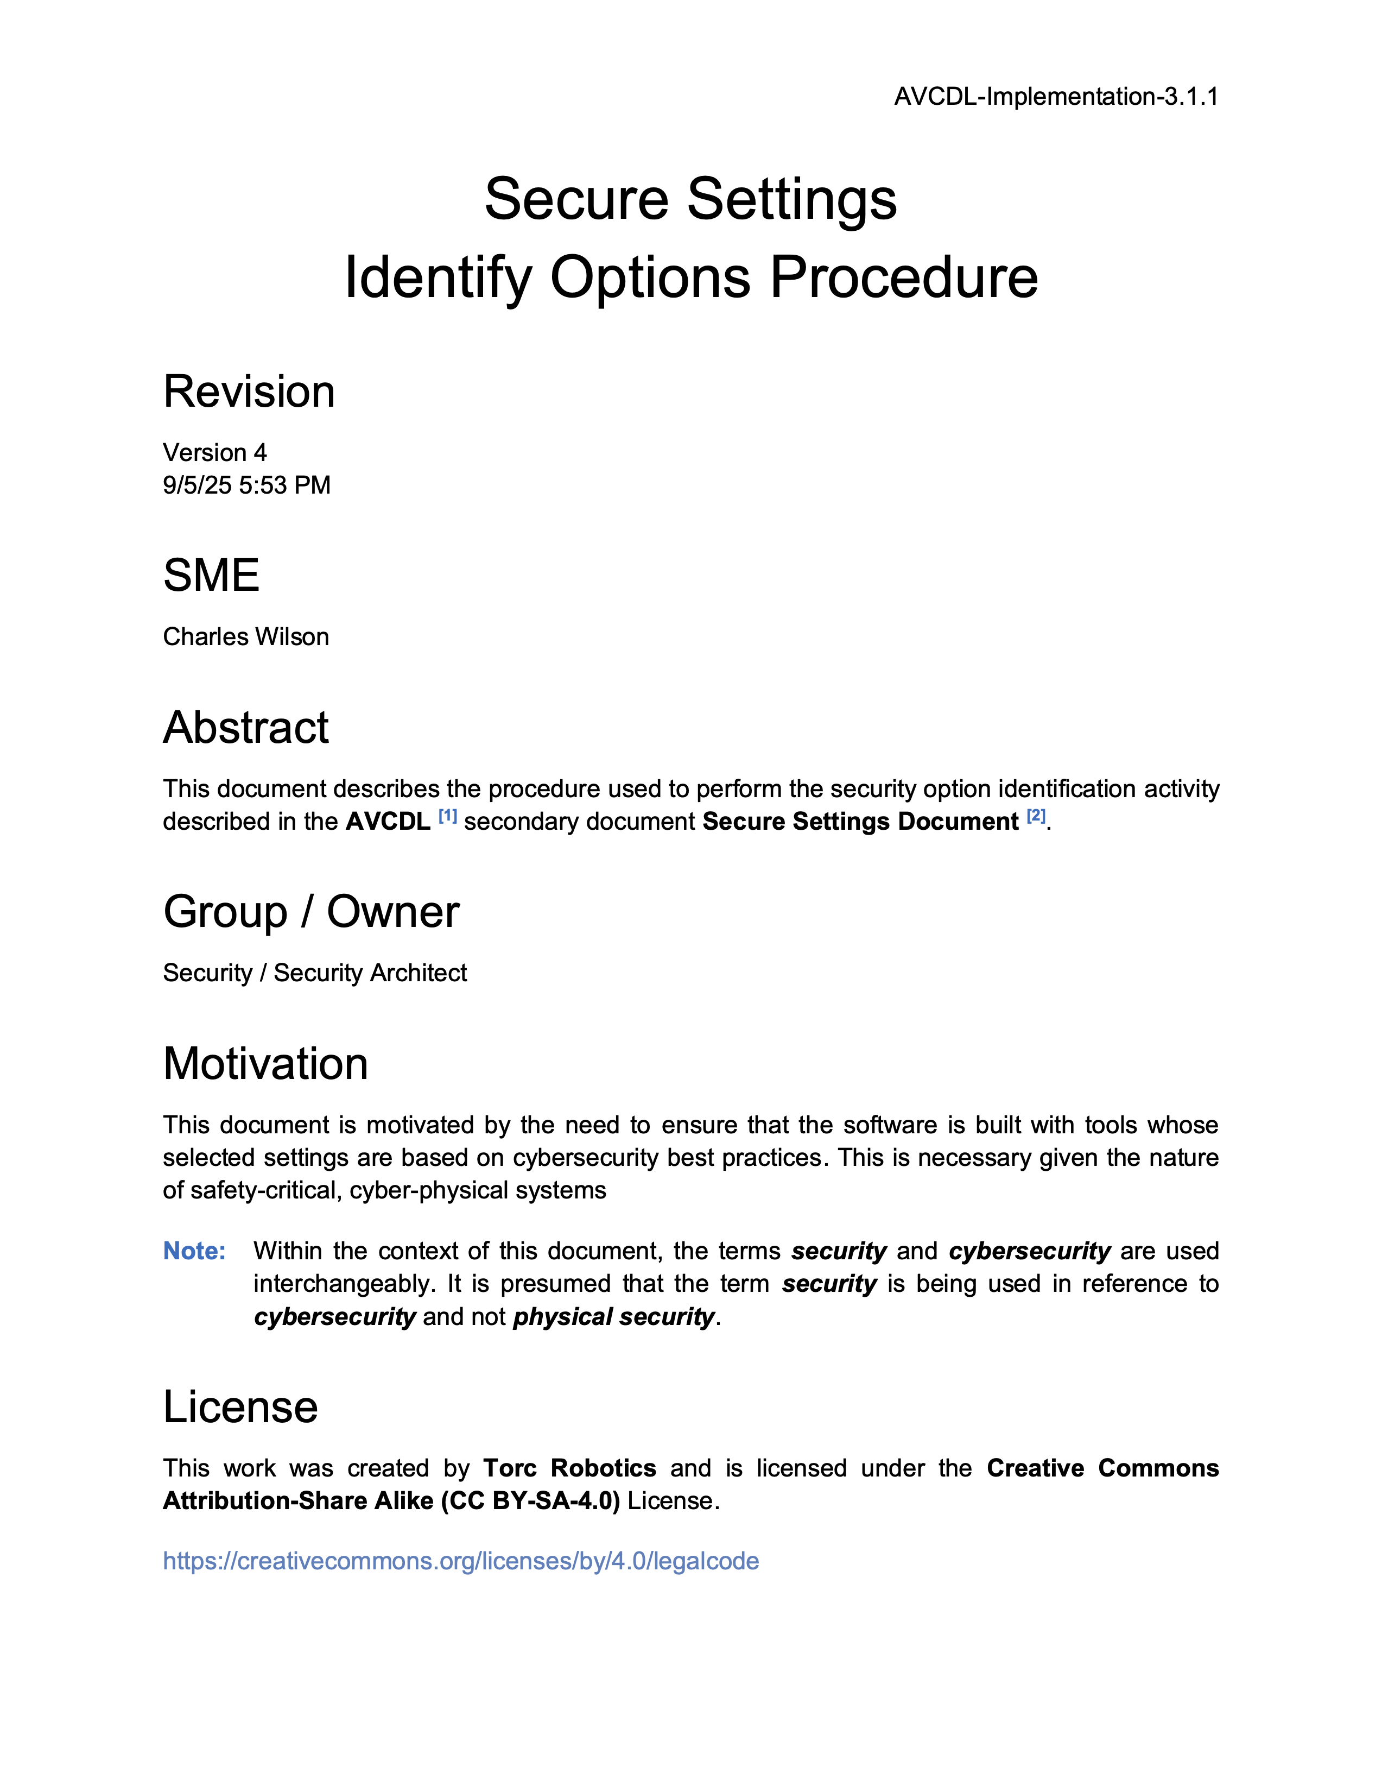
Further Reading
Notes:
Script:
For additional information and to get a more in-depth set of references, the Secure Settings – Identify Options Procedure tertiary document is available in the AVCDL GitHub repository.

Slide 25
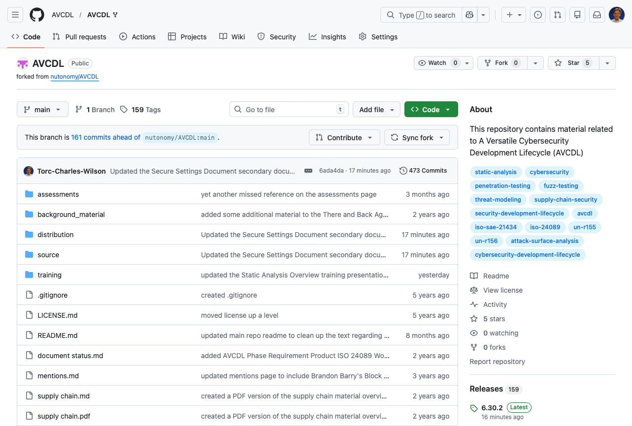
AVCDL on GitHub
https://github.com/AVCDL/AVCDL
Notes:
Script:
All AVCDL materials, both in source and distribution forms, are available on our GitHub site, as shown here.
Because of the size of the repository, it's recommended that you either clone the repository or download a ZIP archive of it, if you're not familiar with using git.
Instructions for downloading a ZIP archive are linked to on the repository’s front page.

Slide 26
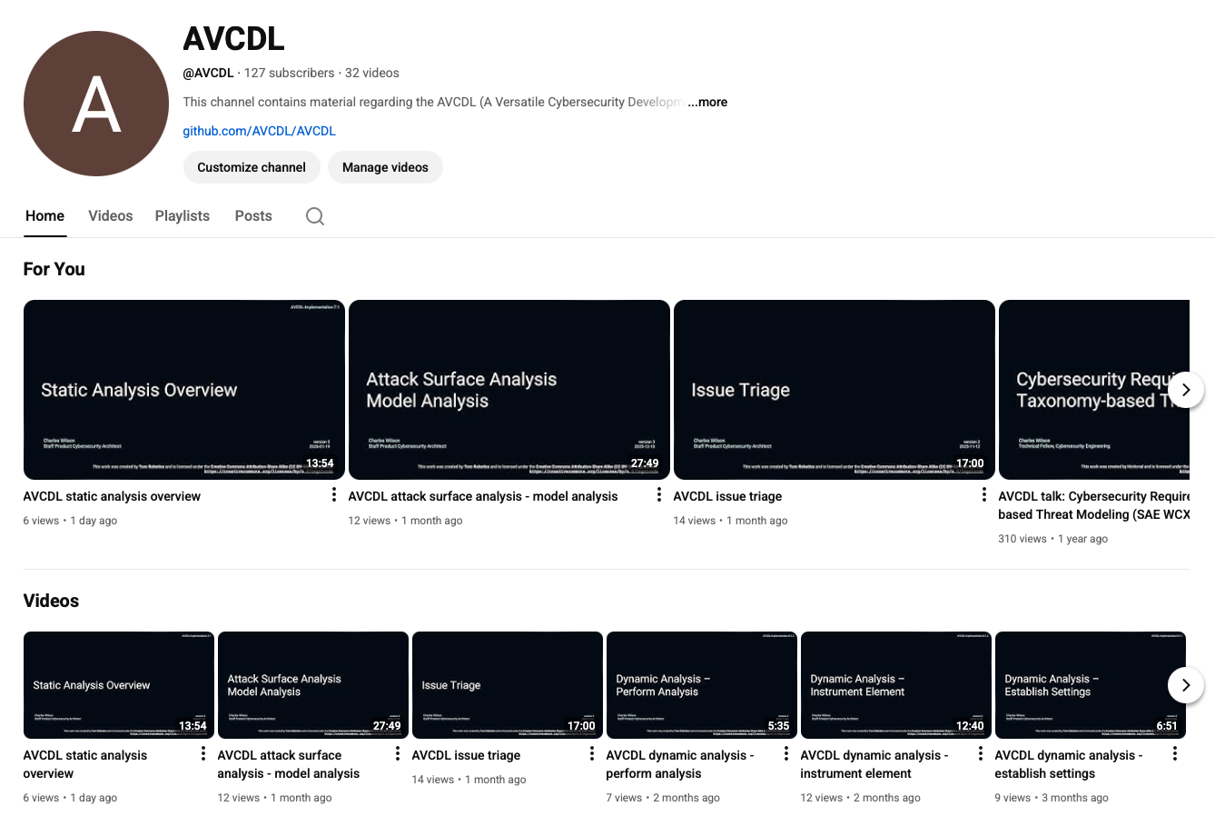
AVCDL on YouTube
https://youtube.com/@AVCDL
Notes:
Script:
Videos covering various aspects of the AVCDL are available on our YouTube channel, as shown here.
It's important to note that all AVCDL materials with the exception of the introductory blog posts are intended for product cybersecurity engineering practitioners.

Slide 27
Next Steps
Notes:
Script:
With this training complete, if you’ve completed the other trainings covering the Secure Settings process activities, you can proceed to the other training at this level, Secure Design Review.
Additionally, if you’ve completed Threat Prioritization you can also proceed to
Attack Surface Analysis
Threat Modeling
Penetration Testing
and
Vulnerability Identification
Additionally, you can proceed to either
Code Reuse
or
Secure Coding

Slide 28
References
AVCDL primary document
Secure Settings Document (AVCDL secondary document)
Secure Settings – Identify Options Procedure (AVCDL tertiary document)
AVCDL tool cybersecurity options template (AVCDL template)
NIST SP 800-231 Bugs Framework (BF): Formalizing Cybersecurity Weaknesses and Vulnerabilities
https://nvlpubs.nist.gov/nistpubs/SpecialPublications/NIST.SP.800-231.pdf
Bugs Framework (BF) Taxonomy
https://usnistgov.github.io/BF
Notes:
Script:
Here are references to the source material used in the creation of this presentation.
They'll also be included in the video description.
Additionally, this presentation’s source material will be provided on the AVCDL GitHub repository.

